Slide 1
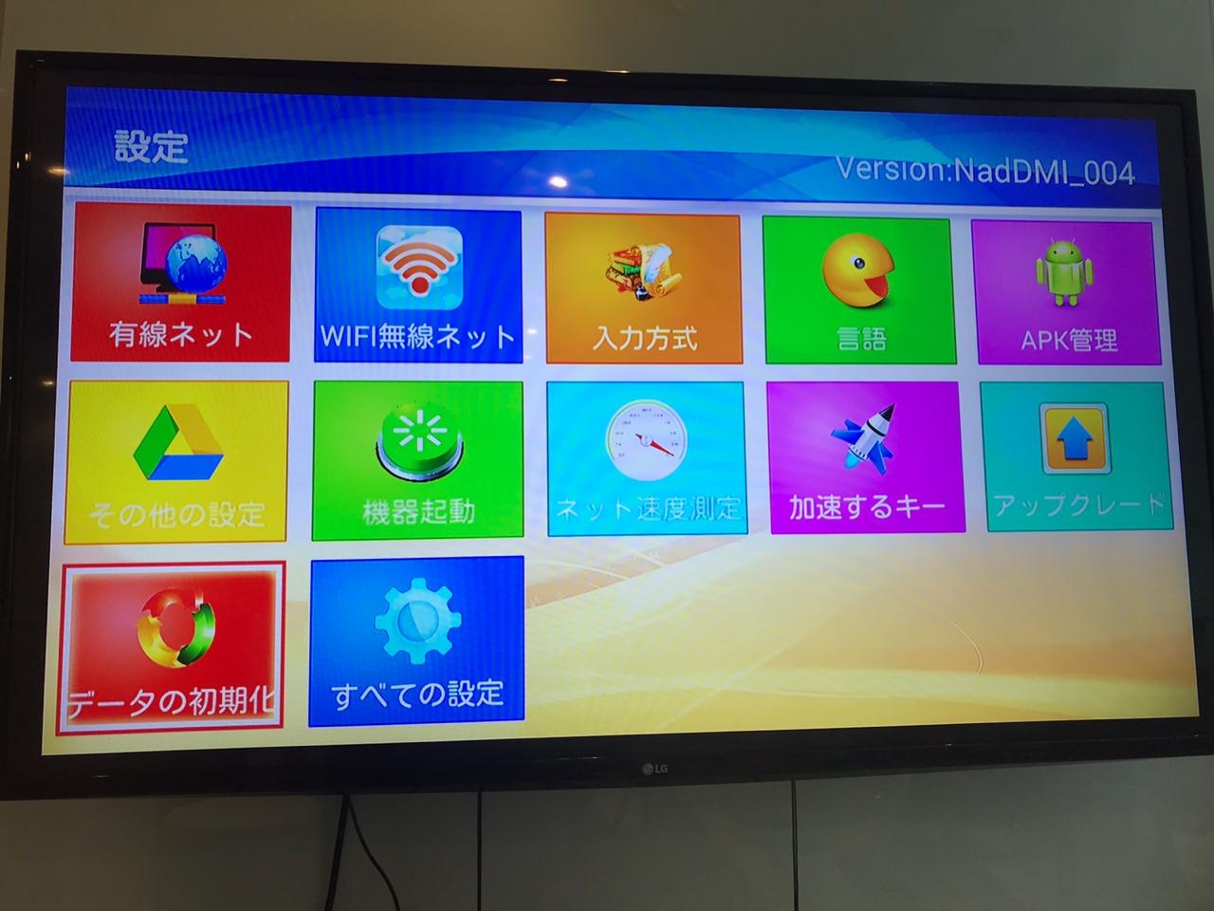
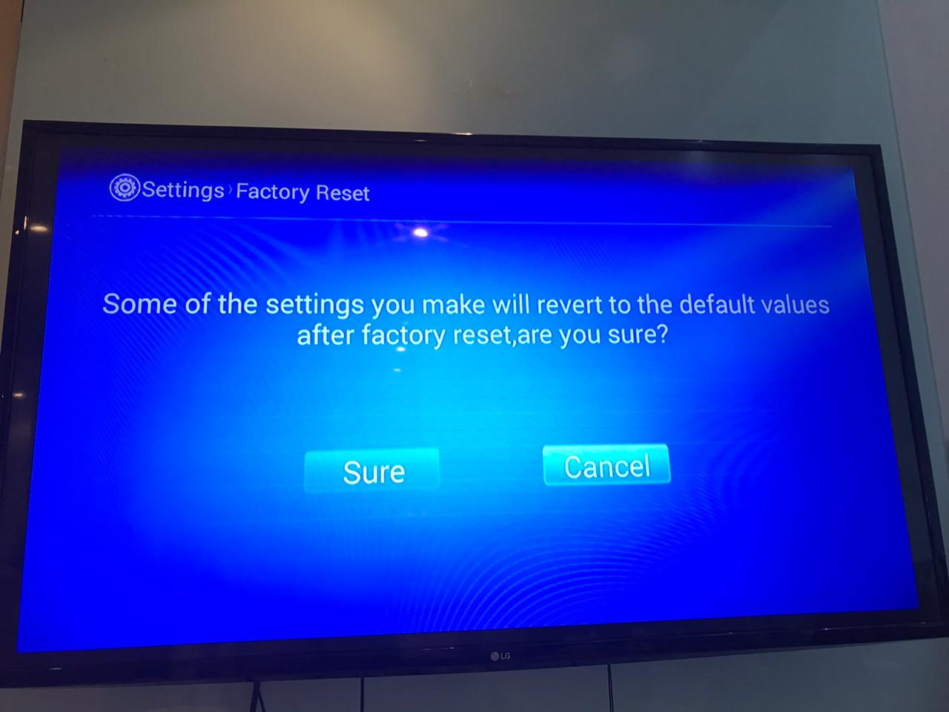
設定(settimg)→データの初期化(Factory reset)
Sure

Slide 2
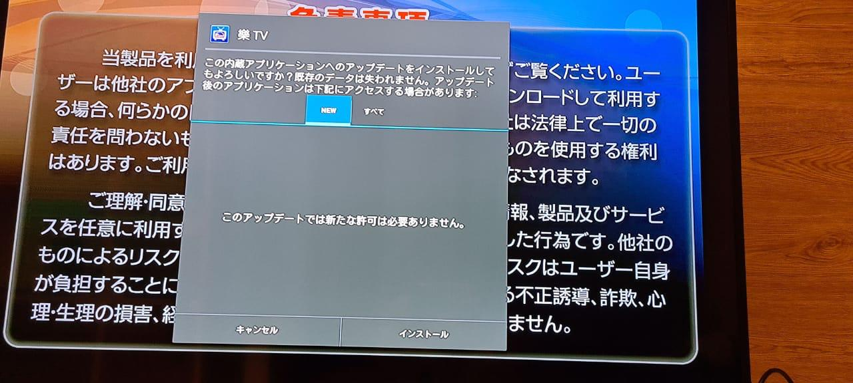
If it request update, install it.

Slide 3
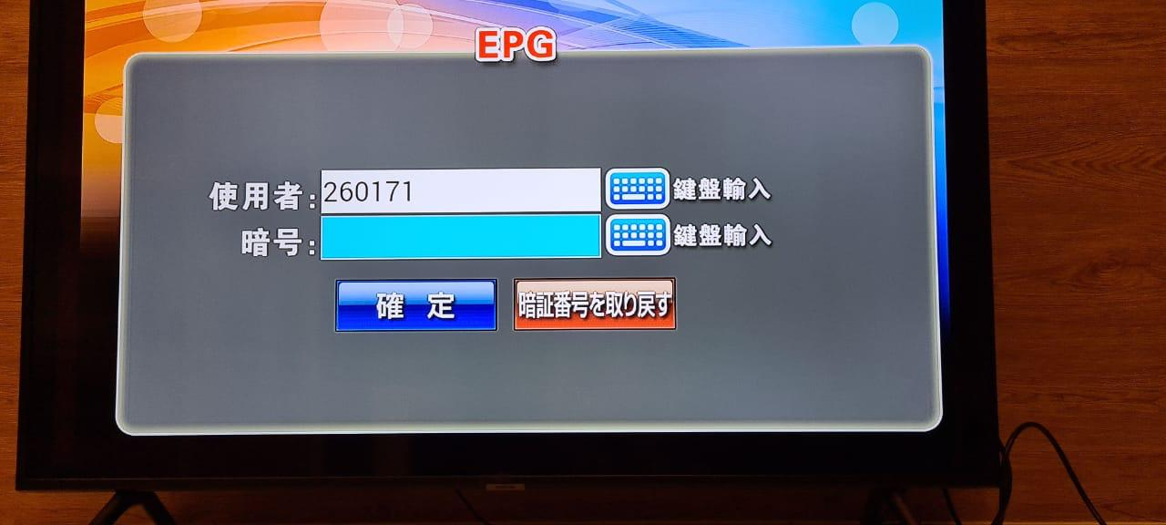
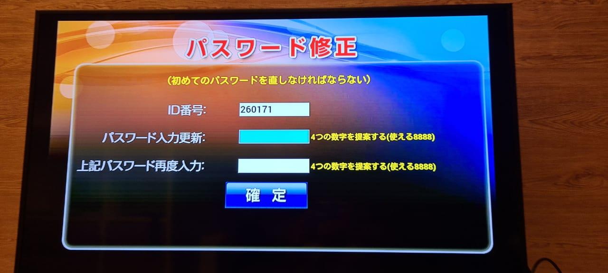
Choice 暗証番号を取り戻す(get back password)
Input 8888 for both then confirm

